Slide 1
Education Inequality Analysis
Michael Cai

Slide 2
Problem
This project aims to utilize data from EdGap.org and the National Center for Education Statistics to analyze how an inequality of educational opportunity affects student's ACT performance.
I will be utilizing multiple regression methods to determine whether there is a correlation between multiple economic factors with ACT performance.
In addition, I will also access whether an area’s college graduate percentage affects the unemployment rate in said area.

Slide 3
Data
Our first dataset comes from EdGap.org, it consists of data from 2016 on several socioeconomic characteristics of multiple school districts as well as the average SAT and ACT performance. EdGap sources its socioeconomic data from the Census Bureau's American Community Survey, and the ACT and SAT data come from each state's Department of Education or some other public source.
Our second dataset contains basic identifying information about schools that comes from the National Center of Education Statistics.

Slide 4
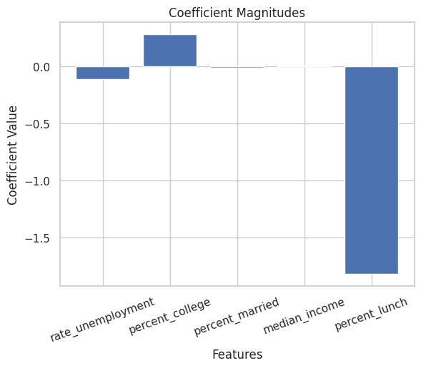
Analysis One, Linear Regression
The linear regression method produced a model that identified a strong negative relationship between the percentage of students on assisted lunch programs and average ACT score, it also identifies a small negative relationship with unemployment rate, a positive relationship with adult college graduation percentage, and little to no relationship with marriage percentage and median income.

Slide 5
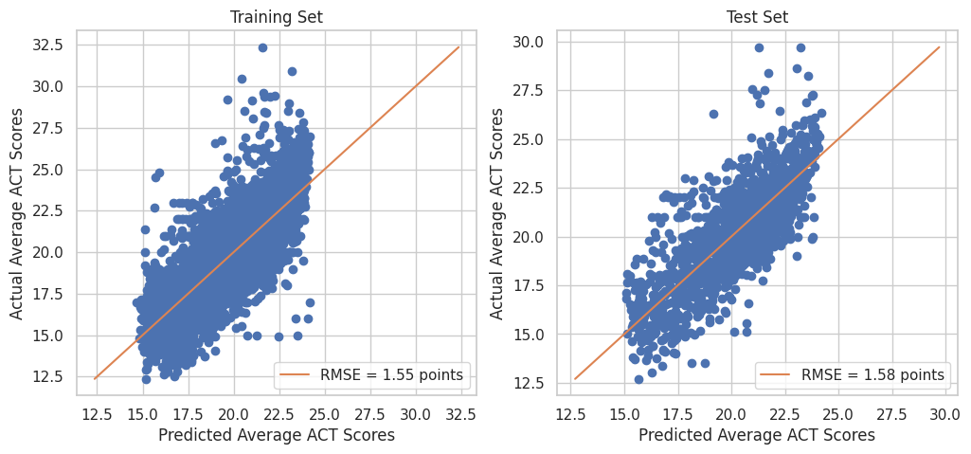
Analysis One, Linear Regression
The training and test set distribution are very similar with a difference in RMSE of only 0.03 points.

Slide 6
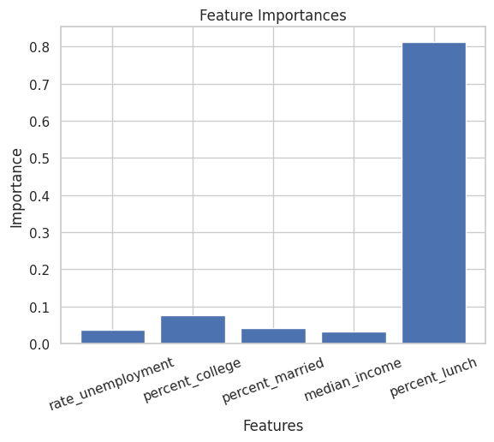
Analysis Two, Decision Tree
The decision tree method produced a model that had similar results as the linear model. Percent_lunch is also the most significant predictor of average ACT score by far with an importance score of around .8. The next highest is percent_college with an importance score of around .08. The others had little importance with scores around .02 to .04.

Slide 7
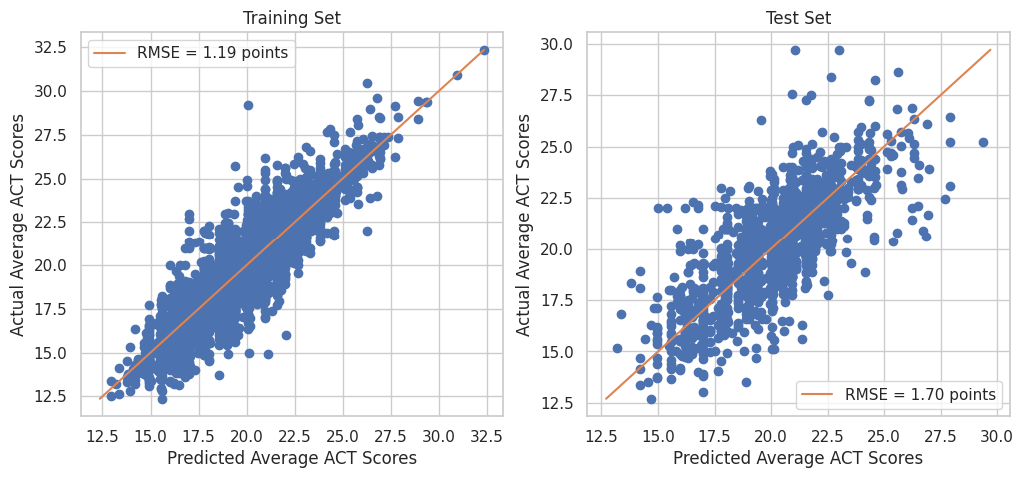
Analysis Two, Decision Tree
The training and test set of the decision tree model varied a lot more, the training set was stronger than the linear model with a RMSE of 1.19 points, however, the test set was weaker with a RMSE of 1.7 points.

Slide 8
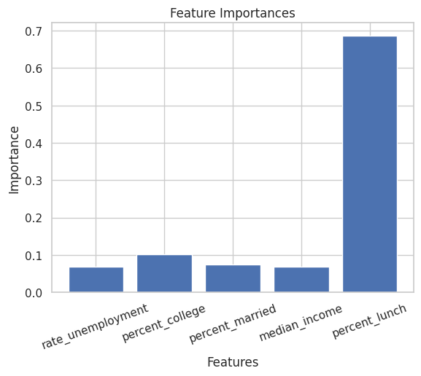
Analysis Three, Random Forest
The final regression method I used was Random Forest, the model produced has the similar importance values as decision tree however, there is more importance for all variables, not just percent lunch. Percent lunch still holds the highest importance score at around .68 but every other feature has risen to around .05 to .1.

Slide 9
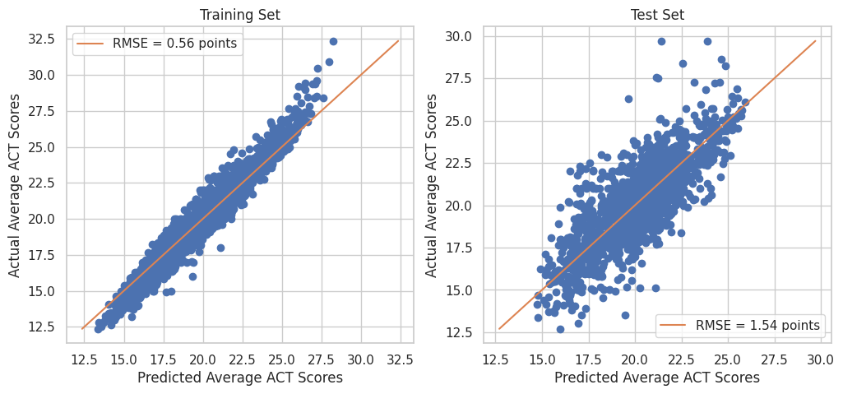
Analysis Three, Random Forest
This model produced a very low RMSE of .56 points for the training set with a good RMSE of 1.54 for the test set. The difference may be a sign of overfitting.

Slide 10
Best Model
Out of the three models, I would choose the Random Forest model as it produced the lowest RMSE for the test set while having a very strong training model. The other models had their strengths but were overall weaker on training, test or both.

Slide 11
Conclusion
From using multiple regression methods to analyze the data, I can conclude that there is a relationship between economic factors and average ACT score. The most significant variable that contributed to predicting ACT score was percent_lunch, this was substantiated by all three models, according to our linear model there is a significant negative correlation meaning an increase in percent_lunch leads to a decrease in average ACT. The next biggest predictor was percent_college with a positive correlation meaning that in areas where there is a higher population of college graduates, kids are likely to get higher ACT scores. The other variables were not as significant in predicting ACT score with them having low correlation coefficients and low importance factors.

Slide 12
Secondary Analysis
To evaluate whether an area’s college graduate percentage affects the unemployment rate in said area I will be using R.
I created a linear model that checks for a relationship between percent_college and rate_unemployment from our Edgap dataset. I will then evaluate this model to figure out what percent of unemployment rate is explained by the percent of college graduates

Slide 13
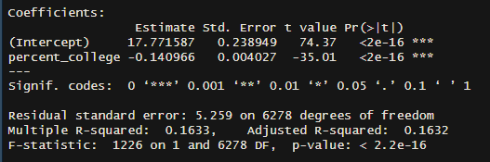
Linear Model
Based on the model, there is a statistically significant relationship between percent_college and rate_unemployment rate at a .001 significance level.
Our model suggests that for every additional 1% increase in percent_college, the unemployment rate decreases by .14% with the intercept being at 17.77%

Slide 14
Testing R-Squared
Taking this model to test with our test dataset, we find that the R-Squared value is .2035 which suggests that around 20% of the variability in unemployment rate of an area can be explained by the percentage of college graduates living in the same area given our data. This means that despite a strong statistical significance, there are other factors that also contribute to predicting unemployment rate.

